Slide 1
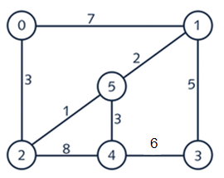
1. Find the minimal spanning tree using Prim’s algorithm. Use
0 as the source vertex . Show the steps.
7
7
1
0
1
0
3
5
3
5
2
4
3
2
4
3
7
7
1
1
0
1
0
2
0
5
5
5
5
1
3
3
8
2
8
4
3
2
8
4
3
2
4
3
0
1
0
1
5
5
V(T) = {0, 1, 2, 3, 4, 5}
E(T) = {(0, 2), (2, 5), (5, 1), (5, 4), (1, 3)}
5
2
4
6
3
2
4
3

Slide 2
Find the minimal spanning tree using Kruskal’s algorithm. Show the weights in order and the steps.
Step 1. List all edges and weights
Step 2: Put them in order by weight
edge
weight
2 – 5 (1)
1 – 5 (2)
0 – 2 (3)
4 – 5 (3)
1 – 3 (5)
4 – 3 (6)
0 – 1 (7)
2 – 4 (8)
0 – 1 (7)
0 – 2 (3)
1 – 3 (5)
1 – 5 (2)
2 – 5 (1)
2 – 4 (8)
4 – 3 (6)
4 – 5 (3)

Slide 3
Find the minimal spanning tree using Kruskal’s algorithm. Show the weights in order and the steps.
Step 3. Add edges to MST
Finished when every vertex can get to every other vertex
  Don’t add connection if both vertices already connected (indirectly)
  If one vertex not in set of vertices, add edge
2 – 5 (1)
1 – 5 (2)
0 – 2 (3)
4 – 5 (3)
1 – 3 (5)
4 – 3 (6)
0 – 1 (7)
2 – 4 (8)
V = {2, 5}
V = {1, 2, 5}
V = {0, 1, 2, 5}
V = {0, 1, 2, 4, 5}
V = {0, 1, 2, 3, 4, 5}
Not needed, I can already
Get from 4 to 3
Not needed, I can already
Get from 0 to 1
Not needed, I can already
Get from 2 to 4

Slide 4
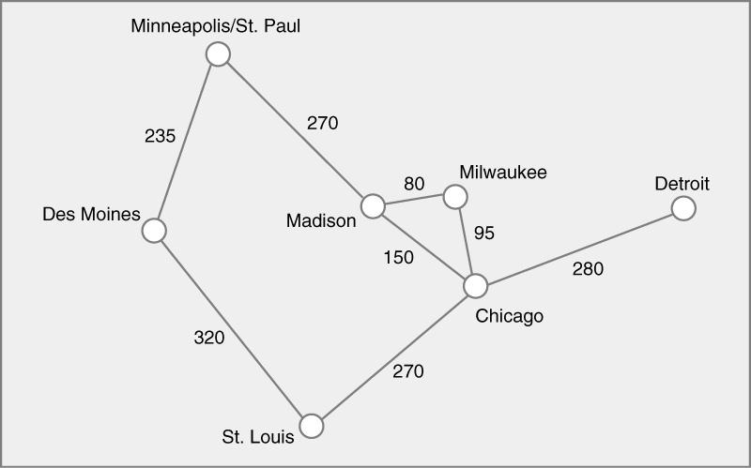
3. Find the minimal spanning tree using the algorithm you prefer. Use
Minneapolis/St. Paul as the source vertex
I will be using Kruskal’s Algorithm

Slide 5
3. Find the minimal spanning tree using the algorithm you prefer. Use
Minneapolis/St. Paul as the source vertex
Step 1. List all edges and weights
edge
weight
Step 2: Put them in order by weight
Minneapolis/St. Paul – Des Moines (235)
Minneapolis/St. Paul – Madison (270)
Des Moines – St. Louis (320)
Madison – Milwaukee (80)
Madison – Chicago (150)
St. Louis – Chicago (270)
Milwaukee – Chicago (95)
Chicago – Detroit (280)
Madison – Milwaukee (80)
Milwaukee – Chicago (95)
Madison – Chicago (150)
Minneapolis/St. Paul – Des Moines (235)
Minneapolis/St. Paul – Madison (270)
St. Louis – Chicago (270)
Chicago – Detroit (280)
Des Moines – St. Louis (320)

Slide 6
Step 3. Add edges to MST
Finished when every vertex can get to every other vertex
  Don’t add connection if both vertices already connected (indirectly)
  If one vertex not in set of vertices, add edge
Madison – Milwaukee (80)
Milwaukee – Chicago (95)
Madison – Chicago (150)
Minn./St. Paul – Des Moines (235)
Minn./St. Paul – Madison (270)
St. Louis – Chicago (270)
Chicago – Detroit (280)
Des Moines – St. Louis (320)
V = {Madison, Milwaukee}
V = {Chicago, Madison, Milwaukee}
Not needed, I can already get from Madison to Chicago
V = {Chicago, Des Moines, Madison, Milwaukee, Minn./St. Paul }
** Minn./St. Paul and Madison were in set of vertices, but there was no current path between them
V = {Chicago, Des Moines, Madison, Milwaukee, Minn./St. Paul, St. Louis }
V = {Chicago, Des Moines, Madison, Milwaukee, Minn./St. Paul, St. Louis, Detroit }
Not needed, I can already get from Madison to Chicago

Slide 7
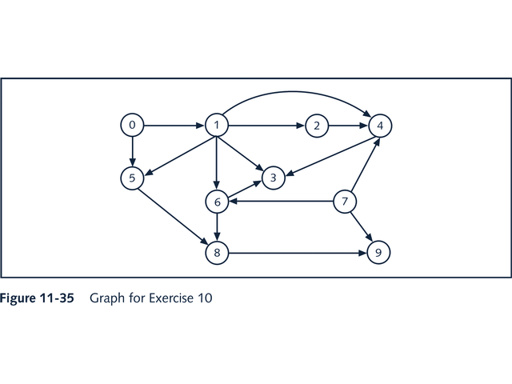
4. List the nodes of the graph in a breadth first topological ordering. Show the
steps using arrays predCount, topologicalOrder and a queue
[0] | [1] | [2] | [3] | [4] | [5] | [6] | [7] | [8] | [9]
predCount
0 | 1 | 1 | 3 | 3 | 2 | 2 | 0 | 2 | 2
topologicalOrder
0
queue
0, 7
predCount for [0] and [7] are 0 – put in queue

Slide 8
4. List the nodes of the graph in a breadth first topological ordering. Show the
steps using arrays predCount, topologicalOrder and a queue
[0] | [1] | [2] | [3] | [4] | [5] | [6] | [7] | [8] | [9]
predCount
0 | 0 | 1 | 3 | 3 | 1 | 2 | 0 | 2 | 2
topologicalOrder
0
queue
7, 1
1. Take [0] out of queue, put in topological order
2. Delete 1 from all successors of [0] : [1] and [5]
3. Place any new indexes of predCount that are now 0 on the queue

Slide 9
4. List the nodes of the graph in a breadth first topological ordering. Show the
steps using arrays predCount, topologicalOrder and a queue
[0] | [1] | [2] | [3] | [4] | [5] | [6] | [7] | [8] | [9]
predCount
0 | 0 | 1 | 3 | 2 | 1 | 1 | 0 | 2 | 1
topologicalOrder
0 | 7
queue
1,
1. Take [7] out of queue, put in topological order
2. Delete 1 from all successors of [7] : [4], [6], and [9]
3. Place any new indexes of predCount that are now 0 on the queue

Slide 10
4. List the nodes of the graph in a breadth first topological ordering. Show the
steps using arrays predCount, topologicalOrder and a queue
[0] | [1] | [2] | [3] | [4] | [5] | [6] | [7] | [8] | [9]
predCount
0 | 0 | 0 | 2 | 1 | 0 | 0 | 0 | 2 | 1
topologicalOrder
0 | 7 | 1
queue
2, 5, 6
1. Take [1] out of queue, put in topological order
2. Delete 1 from all successors of [1] : [2], [3], [4], [5], and [6]
3. Place any new indexes of predCount that are now 0 on the queue

Slide 11
4. List the nodes of the graph in a breadth first topological ordering. Show the
steps using arrays predCount, topologicalOrder and a queue
[0] | [1] | [2] | [3] | [4] | [5] | [6] | [7] | [8] | [9]
predCount
0 | 0 | 0 | 2 | 0 | 0 | 0 | 0 | 2 | 1
topologicalOrder
0 | 7 | 1 | 2
queue
5, 6, 4
1. Take [2] out of queue, put in topological order
2. Delete 1 from all successors of [2] : [4]
3. Place any new indexes of predCount that are now 0 on the queue

Slide 12
4. List the nodes of the graph in a breadth first topological ordering. Show the
steps using arrays predCount, topologicalOrder and a queue
[0] | [1] | [2] | [3] | [4] | [5] | [6] | [7] | [8] | [9]
predCount
0 | 0 | 0 | 2 | 0 | 0 | 0 | 0 | 1 | 1
topologicalOrder
0 | 7 | 1 | 2 | 5
queue
6, 4
1. Take [5] out of queue, put in topological order
2. Delete 1 from all successors of [5] : [4]
3. Place any new indexes of predCount that are now 0 on the queue

Slide 13
4. List the nodes of the graph in a breadth first topological ordering. Show the
steps using arrays predCount, topologicalOrder and a queue
[0] | [1] | [2] | [3] | [4] | [5] | [6] | [7] | [8] | [9]
predCount
0 | 0 | 0 | 1 | 0 | 0 | 0 | 0 | 0 | 1
topologicalOrder
0 | 7 | 1 | 2 | 5 | 6
queue
4, 8
1. Take [6] out of queue, put in topological order
2. Delete 1 from all successors of [6] : [3] and [8]
3. Place any new indexes of predCount that are now 0 on the queue

Slide 14
4. List the nodes of the graph in a breadth first topological ordering. Show the
steps using arrays predCount, topologicalOrder and a queue
[0] | [1] | [2] | [3] | [4] | [5] | [6] | [7] | [8] | [9]
predCount
0 | 0 | 0 | 0 | 0 | 0 | 0 | 0 | 0 | 1
topologicalOrder
0 | 7 | 1 | 2 | 5 | 6 | 4
queue
8, 3
1. Take [4] out of queue, put in topological order
Delete 1 from all successors of [4] : [3]
3. Place any new indexes of predCount that are now 0 on the queue

Slide 15
4. List the nodes of the graph in a breadth first topological ordering. Show the
steps using arrays predCount, topologicalOrder and a queue
[0] | [1] | [2] | [3] | [4] | [5] | [6] | [7] | [8] | [9]
predCount
0 | 0 | 0 | 0 | 0 | 0 | 0 | 0 | 0 | 0
topologicalOrder
0 | 7 | 1 | 2 | 5 | 6 | 4 | 8
queue
3, 9
1. Take [8] out of queue, put in topological order
Delete 1 from all successors of [8] : [9]
3. Place any new indexes of predCount that are now 0 on the queue

Slide 16
4. List the nodes of the graph in a breadth first topological ordering. Show the
steps using arrays predCount, topologicalOrder and a queue
[0] | [1] | [2] | [3] | [4] | [5] | [6] | [7] | [8] | [9]
predCount
0 | 0 | 0 | 0 | 0 | 0 | 0 | 0 | 0 | 0
topologicalOrder
0 | 7 | 1 | 2 | 5 | 6 | 4 | 8 | 3 | 9
queue
9
1. Take [3] out of queue, put in topological order
Delete 1 from all successors of [3] :
3. Place any new indexes of predCount that are now 0 on the queue

Slide 17
4. List the nodes of the graph in a breadth first topological ordering. Show the
steps using arrays predCount, topologicalOrder and a queue
[0] | [1] | [2] | [3] | [4] | [5] | [6] | [7] | [8] | [9]
predCount
0 | 0 | 0 | 0 | 0 | 0 | 0 | 0 | 0 | 0
topologicalOrder
0 | 7 | 1 | 2 | 5 | 6 | 4 | 8 | 3 | 9
queue
1. Take [9] out of queue, put in topological order
Delete 1 from all successors of [9] :
3. Place any new indexes of predCount that are now 0 on the queue

Slide 18
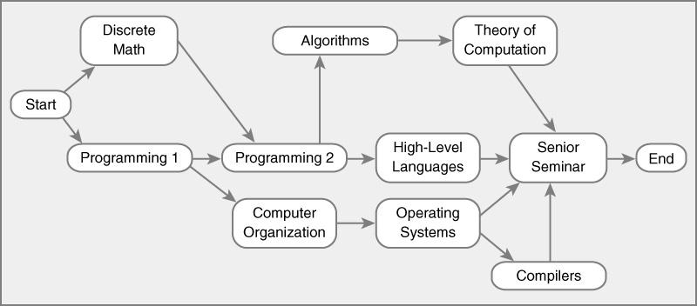
5. List the nodes of the graph in a breadth first topological ordering.
[Start] | [Discrete Math] | [Prog 1] | [Comp Organiz] | [Prog 2.] | [Algorithm] | [High Level] | [OS] | [Theory of] | [Compiler] | [SS] | [end]
Pred
Count
0 | 1, 0 | 1,0 | 1 | 2 | 1 | 1 | 1 | 1 | 1 | 4 | 1
Topological
Order
Start
queue
Start, Discrete, Prog 1,

Slide 19
5. List the nodes of the graph in a breadth first topological ordering.
[Start] | [Discrete Math] | [Prog 1] | [Comp Organiz] | [Prog 2.] | [Algorithm] | [High Level] | [OS] | [Theory of] | [Compiler] | [SS] | [end]
Pred
Count
0 | 0 | 0 | 1 | 2, 1 | 1 | 1 | 1 | 1 | 1 | 4 | 1
Topological
Order
Start | Discrete
queue
Start, Discrete, Prog 1,

Slide 20
5. List the nodes of the graph in a breadth first topological ordering.
[Start] | [Discrete Math] | [Prog 1] | [Comp Organiz] | [Prog 2.] | [Algorithm] | [High Level] | [OS] | [Theory of] | [Compiler] | [SS] | [end]
Pred
Count
0 | 0 | 0 | 1, 0 | 1, 0 | 1 | 1 | 1 | 1 | 1 | 4 | 1
Topological
Order
Start | Discrete | Prog 1
queue
Start, Discrete, Prog 1, Computer Org., Prog 2

Slide 21
5. List the nodes of the graph in a breadth first topological ordering.
[Start] | [Discrete Math] | [Prog 1] | [Comp Organiz] | [Prog 2.] | [Algorithm] | [High Level] | [OS] | [Theory of] | [Compiler] | [SS] | [end]
Pred
Count
0 | 0 | 0 | 0 | 0 | 1 | 1 | 1, 0 | 1 | 1 | 4 | 1
Topological
Order
Start | Discrete | Prog 1 | Computer Org.
queue
Start, Discrete, Prog 1, Computer Org., Prog 2, Operating Systems,

Slide 22
5. List the nodes of the graph in a breadth first topological ordering.
[Start] | [Discrete Math] | [Prog 1] | [Comp Organiz] | [Prog 2.] | [Algorithm] | [High Level] | [OS] | [Theory of] | [Compiler] | [SS] | [end]
Pred
Count
0 | 0 | 0 | 0 | 0 | 1, 0 | 1, 0 | 0 | 1 | 1 | 4 | 1
Topological
Order
Start | Discrete | Prog 1 | Computer Org. | Prog 2
queue
Start, Discrete, Prog 1, Computer Org., Prog 2, Operating Systems, Algorithm, High-Level

Slide 23
5. List the nodes of the graph in a breadth first topological ordering.
[Start] | [Discrete Math] | [Prog 1] | [Comp Organiz] | [Prog 2.] | [Algorithm] | [High Level] | [OS] | [Theory of] | [Compiler] | [SS] | [end]
Pred
Count
0 | 0 | 0 | 0 | 0 | 0 | 0 | 0 | 1 | 1, 0 | 4, 3 | 1
Topological
Order
Start | Discrete | Prog 1 | Computer Org. | Prog 2 | Operating Systems
queue
Start, Discrete, Prog 1, Computer Org., Prog 2, Operating Systems, Algorithm, High-Level, Compilers,

Slide 24
5. List the nodes of the graph in a breadth first topological ordering.
[Start] | [Discrete Math] | [Prog 1] | [Comp Organiz] | [Prog 2.] | [Algorithm] | [High Level] | [OS] | [Theory of] | [Compiler] | [SS] | [end]
Pred
Count
0 | 0 | 0 | 0 | 0 | 0 | 0 | 0 | 1, 0 | 0 | 3 | 1
Topological
Order
Start | Discrete | Prog 1 | Computer Org. | Prog 2 | Operating Systems | Algorithm
queue
Start, Discrete, Prog 1, Computer Org., Prog 2, Operating Systems, Algorithm, High-Level, Compilers, Theory,

Slide 25
5. List the nodes of the graph in a breadth first topological ordering.
[Start] | [Discrete Math] | [Prog 1] | [Comp Organiz] | [Prog 2.] | [Algorithm] | [High Level] | [OS] | [Theory of] | [Compiler] | [SS] | [end]
Pred
Count
0 | 0 | 0 | 0 | 0 | 0 | 0 | 0 | 0 | 0 | 3, 2 | 1
Topological
Order
Start | Discrete | Prog 1 | Computer Org. | Prog 2 | Operating Systems | Algorithm | High-Level
queue
Start, Discrete, Prog 1, Computer Org., Prog 2, Operating Systems, Algorithm, High-Level, Compilers, Theory,

Slide 26
5. List the nodes of the graph in a breadth first topological ordering.
[Start] | [Discrete Math] | [Prog 1] | [Comp Organiz] | [Prog 2.] | [Algorithm] | [High Level] | [OS] | [Theory of] | [Compiler] | [SS] | [end]
Pred
Count
0 | 0 | 0 | 0 | 0 | 0 | 0 | 0 | 0 | 0 | 2, 1 | 1
Topological
Order
Start | Discrete | Prog 1 | Computer Org. | Prog 2 | Operating Systems | Algorithm | High-Level | Compilers
queue
Start, Discrete, Prog 1, Computer Org., Prog 2, Operating Systems, Algorithm, High-Level, Compilers, Theory,

Slide 27
5. List the nodes of the graph in a breadth first topological ordering.
[Start] | [Discrete Math] | [Prog 1] | [Comp Organiz] | [Prog 2.] | [Algorithm] | [High Level] | [OS] | [Theory of] | [Compiler] | [SS] | [end]
Pred
Count
0 | 0 | 0 | 0 | 0 | 0 | 0 | 0 | 0 | 0 | 1, 0 | 1
Topological
Order
Start | Discrete | Prog 1 | Computer Org. | Prog 2 | Operating Systems | Algorithm | High-Level | Compilers | Theory
queue
Start, Discrete Math, Prog 1, Computer Org., Prog 2, Operating Systems, Algorithm, High-Level, Compilers, Theory, Senior Seminar

Slide 28
5. List the nodes of the graph in a breadth first topological ordering.
[Start] | [Discrete Math] | [Prog 1] | [Comp Organiz] | [Prog 2.] | [Algorithm] | [High Level] | [OS] | [Theory of] | [Compiler] | [SS] | [end]
Pred
Count
0 | 0 | 0 | 0 | 0 | 0 | 0 | 0 | 0 | 0 | 0 | 1, 0
Topological
Order
Start | Discrete | Prog 1 | Computer Org. | Prog 2 | Operating Systems | Algorithm | High-Level | Compilers | Theory | Senior Seminar
queue
Start, Discrete Math, Prog 1, Computer Org., Prog 2, Operating Systems, Algorithm, High-Level, Compilers, Theory, Senior Seminar, End

Slide 29
5. List the nodes of the graph in a breadth first topological ordering.
[Start] | [Discrete Math] | [Prog 1] | [Comp Organiz] | [Prog 2.] | [Algorithm] | [High Level] | [OS] | [Theory of] | [Compiler] | [SS] | [end]
Pred
Count
0 | 0 | 0 | 0 | 0 | 0 | 0 | 0 | 0 | 0 | 0 | 0
Topological
Order
Start | Discrete | Prog 1 | Computer Org. | Prog 2 | Operating Systems | Algorithm | High-Level | Compilers | Theory | Senior Seminar | End
queue
Start, Discrete Math, Prog 1, Computer Org., Prog 2, Operating Systems, Algorithm, High-Level, Compilers, Theory, Senior Seminar, End

